Slide 1

Swedish Third-party motor insurance claims
Brian Collins

Slide 2

Agenda
Exploratory data analysis
Correlation between variables
Regression modelling of data
New branch office analysis
Application of models for prediction

Slide 3

Data Overview
Kilometres – Listing distance groups in order from smallest to largest.
Zone – Clustering regions of the country, in a broadly descending order of size.
Bonus – Representing the number of years no claims bonus (NCB) since the last claim plus one.
Make – Integers representing the eight most popular car manufacturers in Sweden. All other vehicles are clustered into group nine.
Insured – The number of the insured policy years.
Claims – Representing the number of claims made against insurance policies.
Payment – Total value of insurance pay-outs made against policies in Swedish Krona (Skr).

Slide 4
Exploratory data analysis

Slide 5
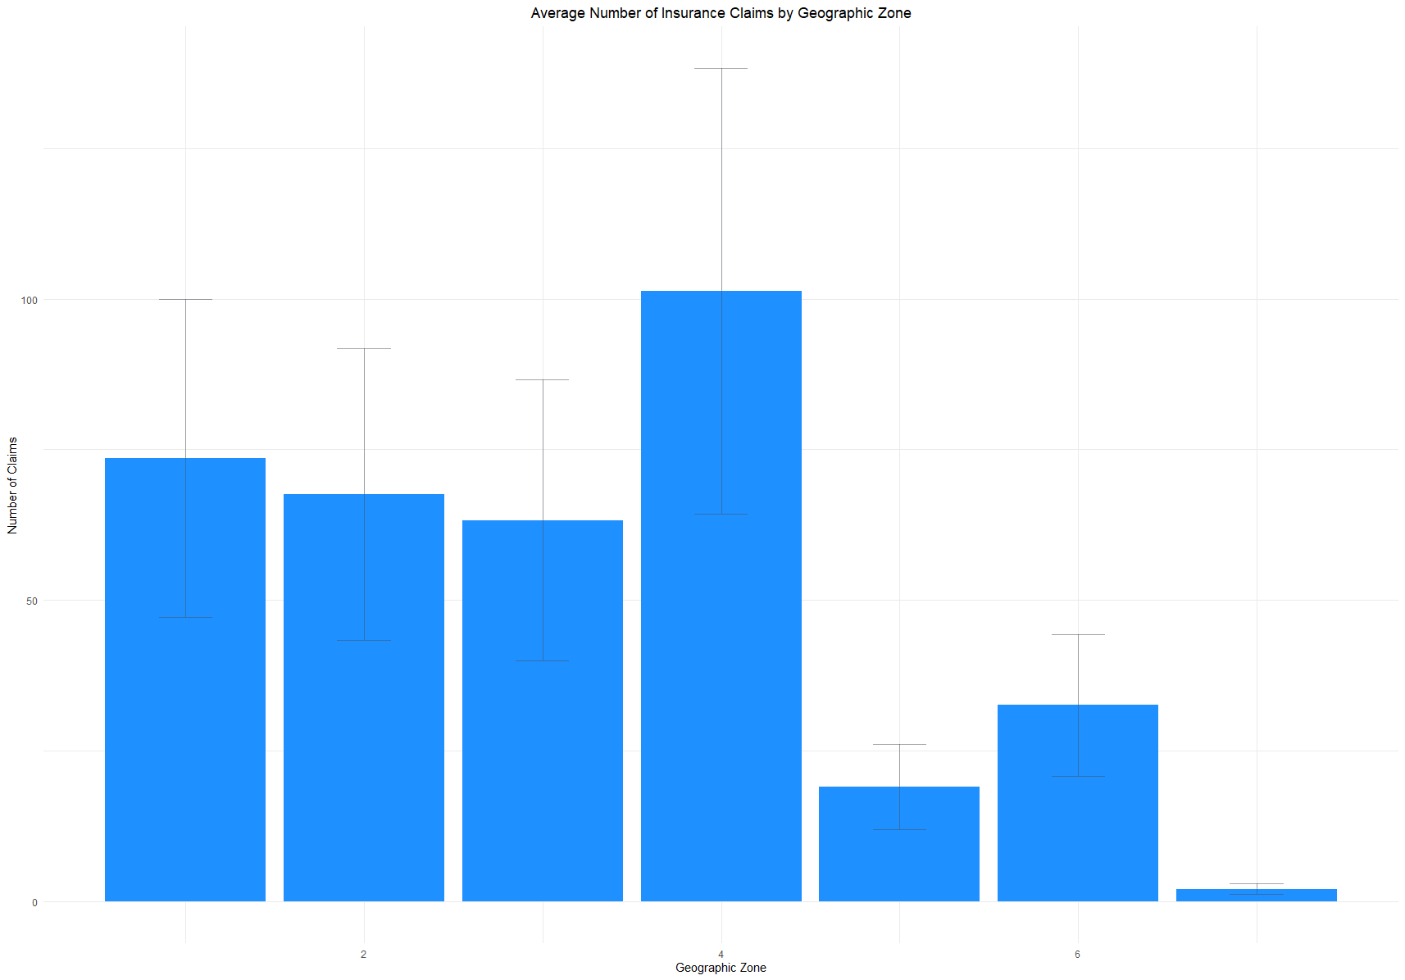
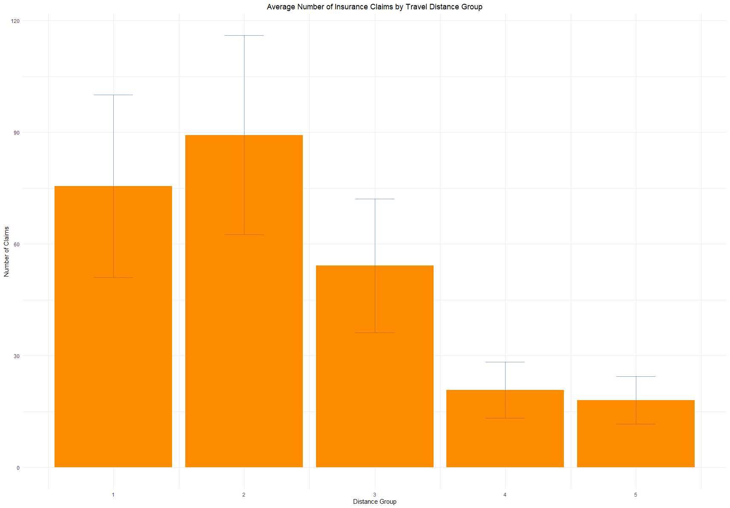
Plotting the variables
Zone
Kilometres
Notes:
Distance groups 1 and 2 exhibit the most significant average claims, with mean claims per group decreasing for distance groups 3-5. This is likely due to fewer, more professional drivers displaying markers of decreased risk

Slide 6
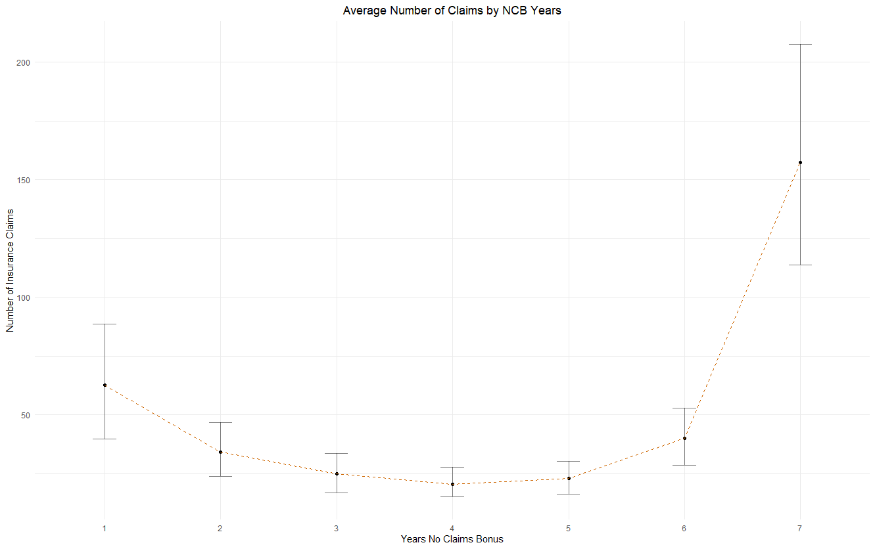
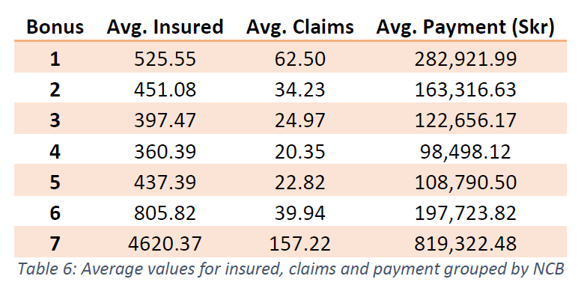
Plotting the variables
Exex
Exex
Bonus
Notes:
With respect to no claims bonus, a clear displaying an increased risk for drivers in their first year. The number of claims then rises for drivers in the later clusters, logically due to the number of drivers, illustrated in Table 6. Bonus

Slide 7
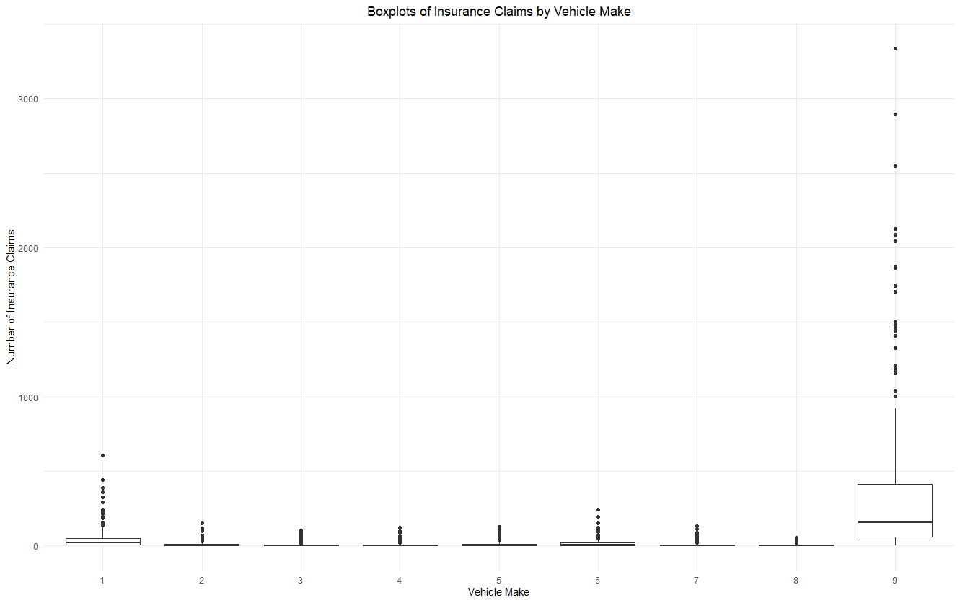
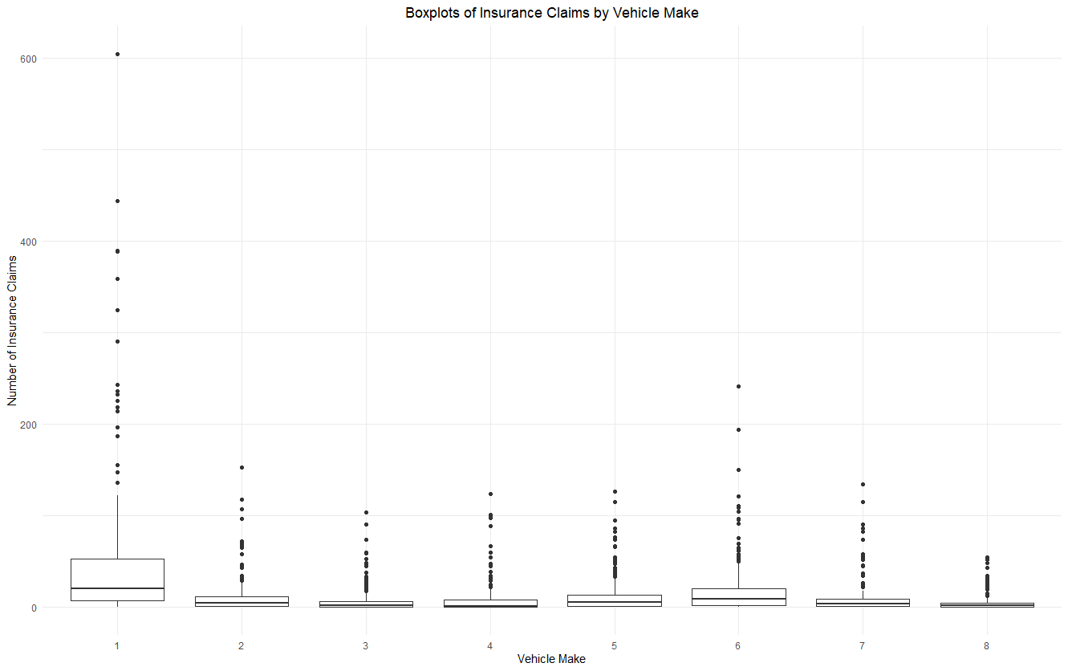
Make
Plotting the variables
Notes:
Figure 6a illustrates the significant number of vehicles that fall outside of the central cluster of 8 manufacturers, with a considerable number of outliers falling in that category concerning claims. Figure 6b presents an exploded view of the boxplots facilitating a clearer understanding of vehicle claims by Make, illustrating that the total number of claims is significantly higher for manufacturer group 1.

Slide 8
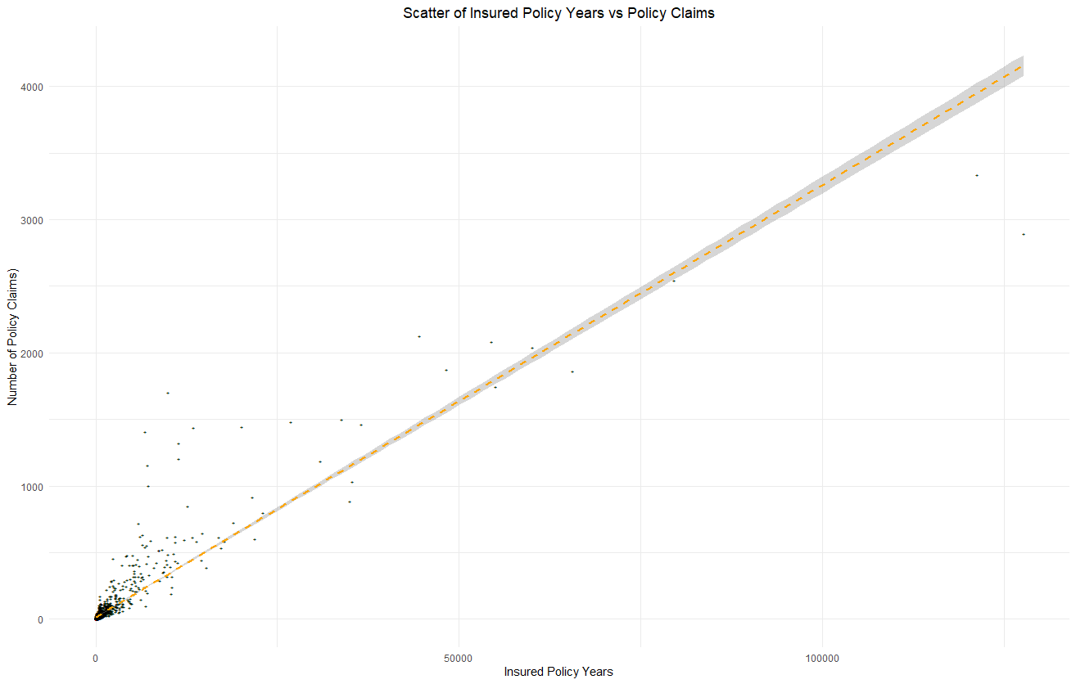
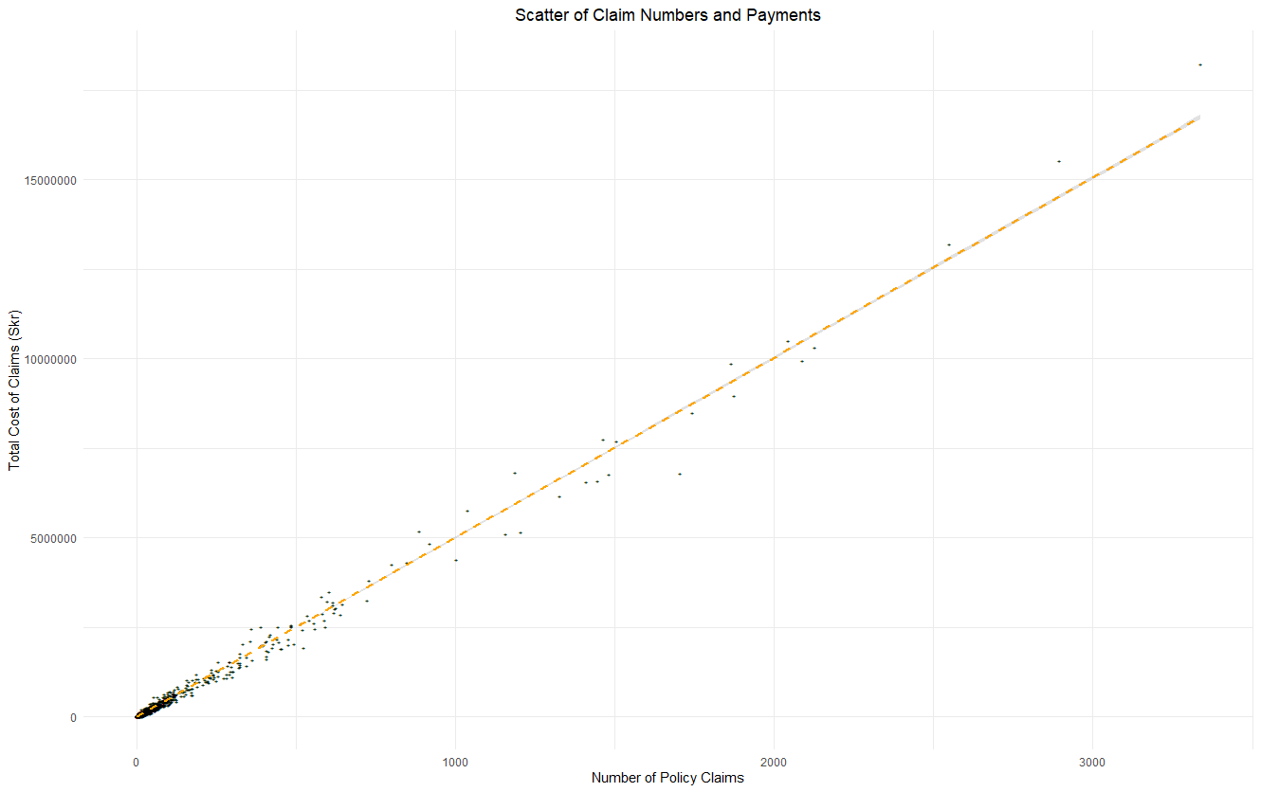
Plotting the variables
Insured
Claims

Slide 9
Correlation between variables

Slide 10
Spearman’s Rho Correlation
Correlation Coefficients
 | Kilometres | Zone | Bonus | Make | Insured | Claims | Payment
Kilometres | 1 | -0.01393 | 0.007206 | -0.00268 | -0.32902 | -0.26426 | -0.24218
Zone | -0.01393 | 1 | 0.011674 | -0.00519 | -0.32006 | -0.38682 | -0.36345
Bonus | 0.007206 | 0.011674 | 1 | 0.002157 | 0.351141 | 0.197773 | 0.202058
Make | -0.00268 | -0.00519 | 0.002157 | 1 | 0.111041 | 0.112388 | 0.118209
Insured | -0.32902 | -0.32006 | 0.351141 | 0.111041 | 1 | 0.933337 | 0.903032
Claims | -0.26426 | -0.38682 | 0.197773 | 0.112388 | 0.933337 | 1 | 0.962443
Payment | -0.24218 | -0.36345 | 0.202058 | 0.118209 | 0.903032 | 0.962443 | 1
Correlation P-Values
 | Kilometres | Zone |  | Bonus | Make | Insured | Claims | Payment
Kilometres | NA | 0.515516 |  | 0.736568 | 0.900551 | 0 | 0 | 0
Zone | 0.515516 | NA |  | 0.58573 | 0.80857 | 0 | 0 | 0
Bonus | 0.736568 | 0.58573 |  | NA | 0.919784 | 0 | 0 | 0
Make | 0.900551 | 0.80857 |  | 0.919784 | NA | 1.99E-07 | 1.41E-07 | 3.06E-08
Insured | 0 | 0 |  | 0 | 1.99E-07 | NA | 0 | 0
Claims | 0 | 0 |  | 0 | 1.41E-07 | 0 | NA | 0
Payment | 0 | 0 |  | 0 | 3.06E-08 | 0 | 0 | NA
Notes:
A Shapiro-Wilk was used to ascertain the probability of data having been sampled from a normally distributed population. For all variables, the test indicated that this probability was 2.2e-16, suggesting a very low probability of observed results being sampled from a normally distributed population. With this in mind, Spearman's Rho was selected given the previously established monotonic relationship, the non-normalcy of the data distribution, and variable types.
The top table presents, as a matrix, the Spearman's Correlation Coefficients between all variables in the dataset. Now just by way of brief context to aid in interpretation of these results, a correlation coefficient of 0.1 would indicate a weak correlation, 0.3 would be moderate, and 0.5 represents a significant correlation. With this in mind you can see that payment has a strong positive correlation with both claim number and the number of insured in policy years, with values of 0.903 and 0.9624, respectively. Bonus and Make also both had weak positive correlations with Payment, with 0.202 and 0.118, respectively. Finally, Kilometres and Zone both had moderate negative correlations of -0.242 and -0.363, respectively.
In the lower table we can see the correlation p-values, we’re looking for these to be below the confidence interval of 0.05, which in all cases they are, so we can state that the correlations that I have mentioned above a
These correlation coefficients suggest the following statements concerning the correlation between variables:
As the number of policy claims increases, so to do the total value of payouts made.
The number of insured policy years for a given Zone, distance, Bonus, and Make displays a significant positive correlation with the value of insurance payouts.
Smaller distance groups display higher risk markers, likely due to the smaller number of professional drivers covering the longer distances.
Insurance payments increase with proximity to Sweden's largest cities. However, the correlation coefficient is comparatively weak because of the significant number of claims and the value of payments in rural Zone 4 (figures 3 & 4).
There is a weak positive correlation for both Bonus and Make with Payments. However, this is likely due to large payments values associated with the largest categories of both variables.

Slide 11
Regression modelling of data & New branch office analysis

Slide 12
Creating models for Payment & Claims
Payment
Claims
Initial model: Claims + Insured + Kilometres + Zone + Bonus
R² = 0.9952, F-Statistic > Critical Value and p-value below C.I. but VIF 3.048265 because of multicollinearity between Insured and Claims.
Insured Model: Insured + Kilometres + Zone + Bonus
R² = 0.8748, F-Statistic > critical value and p-value below C.I. and VIF 1.023519.
Claims Model: Claims + Kilometres + Zone + Bonus
R² = 0.9912, F-Statistic > critical value and p-value below C.I. and VIF 1.022149.
Initial model: Payment + Insured + Kilometres + Zone + Make + Bonus
R² = 0. 9937, F-Statistic > Critical Value and p-value below C.I. but VIF 3.436533 because of multicollinearity between Insured and Payment.
Insured Model: Insured + Kilometres + Zone + Bonus
R² = 0.8425, F-Statistic > critical value and p-value below C.I. and VIF 0.8425.
Payment Model: Payment + Kilometres + Zone + Bonus
R² = 0.9913, F-Statistic > critical value and p-value below C.I. and VIF 1.044052.
Notes:
So as a very brief reminder, a regression modelling is a method of using the interaction between known variables to predict unknown values.
Initially, a generalised regression model was created using all potential independent variables for both targets. This general model served as a basis for a stepwise approach to determining possible models for implementation. Outputs from the stepwise approach were then compared to determine which predictor variables were best suited for testing analysis.
Once initial models were suggested through the stepwise approach they were tested for goodness of fit for the underlying data. These models allow us to understand how well they fit observed data, seen in the R2 value which is a value between 0 and 1, with a value of one meaning that all movements in our dependent variable is explained by movements in our independent variables. Further to this the F-statistic and p-value help us understand whether the results observed are likely to have happened by chance and be unrepresentative of the underlying population, in all cases these values suggested that our results were significant and didn’t illustrate sample bias so we’ll ignore these for the rest of this presentation. A final important consideration in each case was the variance inflation factor, which is a measure of the amount of multicollinearity in a set of multiple regression variables.
In the case of both of our initial models, our Mean VIF was significantly above 1 and as such we needed to account for this multicollinearity through variable selection. This was achieved through creation of two further models subtracting one of the two variables with high correlation in each initial model.

Slide 13
Assessing model fit
Payment
Claims
Insured Model: Insured + Kilometres + Zone + Bonus
1.6% of observations had a standardised residual greater than 2.58
Two observations had a cooks distance of greater than 1.
Claims Model: Claims + Kilometres + Zone + Bonus
0.82% of observations had a standardised residual greater than 2.58
Three observations had a Cooks Distance of greater than 1.
Insured Model: Insured + Kilometres + Zone + Bonus
1.56% of observations had a standardised residual greater than 2.58
Two observations had a cooks distance of greater than 1.
Payment Model: Payment + Kilometres + Zone + Bonus
2.11% of observations had a standardised residual greater than 2.58
Three observations had a Cooks Distance of greater than 1.
Notes:
So to further assess model fit I then established both the standardised residual for each observation in the dataset which illustrates the difference between the value predicted by our model and our observed value, divided by the standard deviation. In addition to utalising cooks distance which helps us to understand whether outliers were having a significant impact on the predictions of our model.
In the case of payment, the claims model provides a superior prediction of the target variable. As I mentioned on the previous page, the model has an r2 value of 0.9912 and error is kept within acceptable limits, with 0.82% of observations having a standardised residual > 2.58.
In the case of claims prediction, the insured model provides an acceptable level of fit with the underlying data. In all cases however, observations had Cook’s Distances exceeding 1, indicating an unacceptable level of influence on the overall model. A contributing factor to this lies in the significant outlier values of two observations representing low mileage, vehicle type 9 and rural areas in southern Sweden. This could indicate an error in the underlying data, or potentially given the prominence of the agricultural industry in southern Sweden, could be valid given the prevalence of expensive farm equipment representing significant insured values. These observations could be removed to reduce their impact on the model. However, if the values were valid, the impact of this on financial planning could be significant. Therefore further investigation into the validity of these observations is necessary.

Slide 14
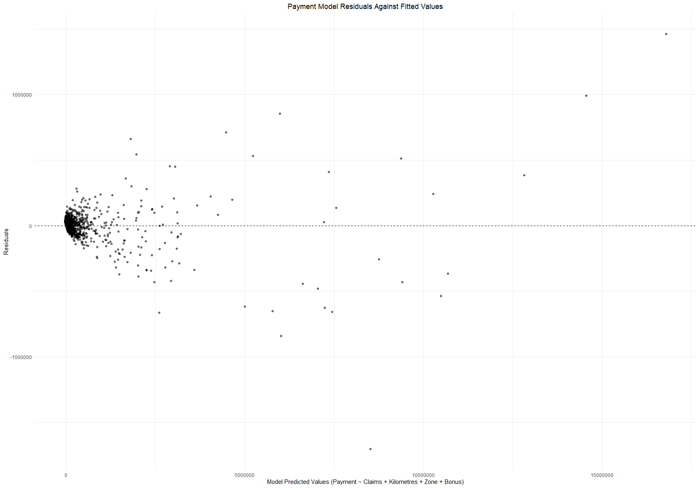
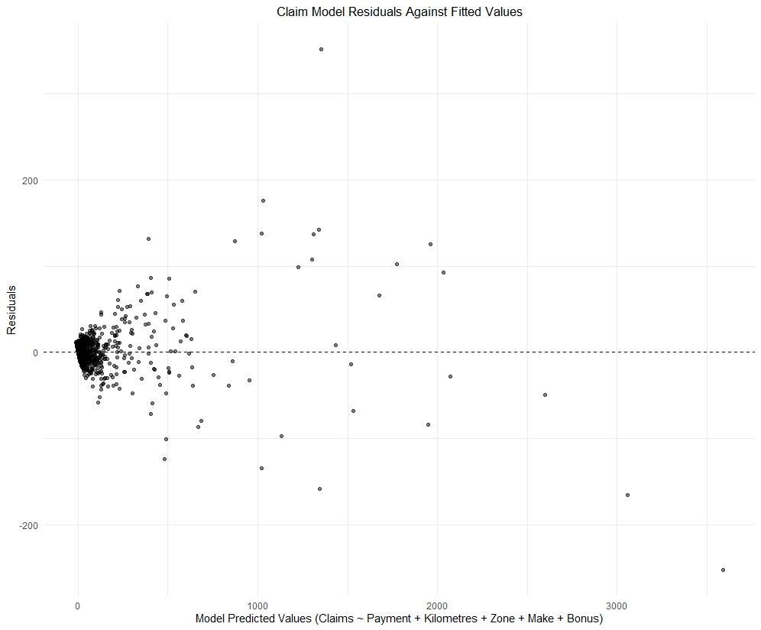
Plotting model residuals
Payment
Claims
Notes:
A final point to raise on model fit is illustrated on these residual plots, which simply plot the residual around 0 of all observations within our dataset. In an ideal world, the expectation would be for these values to be evenly dispersed around zero, which is not true in either case. Suggesting a level of heteroscedasticity in the underlying data. Now while we have an acceptable fit of model when it comes to describing the dataset we must be careful about generalising findings from outside the sample dataset.

Slide 15
Model Coefficients and Standardised Beta Values
Claims Model
Payment Model
Insured Model
Independent Variable | Model Coefficient | Standardised Beta
Payment | 0.000196617 | 0.99159103
Zone | -1.296011876 | -0.01277861
Bonus | -1.184765672 | -0.01175021
Make | 0.908853427 | 0.01165606
Kilometres | -1.236444403 | -0.00864551
Independent Variable | Model Coefficient | Standardised Beta
Claims | 5024.4 | 0.996258187
Bonus | 6680.12 | 0.013136659
Zone | 5886.98 | 0.011509448
Kilometres | 5158.24 | 0.007151628
Independent Variable | Model Coefficient | Standardised Beta
Payment | 0.0161175 | 2.89623981
Claims | -55.3689629 | -1.9728323
Bonus | 87.9712821 | 0.03108693
Make | -44.3630424 | -0.0202723
Kilometres | -66.4985759 | -0.01656732
Notes:
To discuss the importance of the variables within each model we can refer towards the model coefficient or beta values. These values tell us about the relationship between our target and predictor variables, If the value is positive we can tell there is a positive relationship between the target and predictor variable, and vice versa. The b-values also tell us to what degree each predictor affects the outcome if the effects of all other predictors are held constant.
While the b-values are important to look at, they are still difficult to interpret objectively because they’re reliant on the underlying units of measurement of the variables. So to allow us to gain a greater understanding of the affect of a variable we can look towards a standardised beta value, which tells us the number of standard deviations by which the target variable will change as a result of a single standard deviation change in the predictor variable. As such they provide us with a better understanding of the ranked importance of a predictor in it’s underlying model.
To that extent you can see the predictors ranked for each model on the basis of their standardised beta value here.

Slide 16
Application of models for prediction

Slide 17
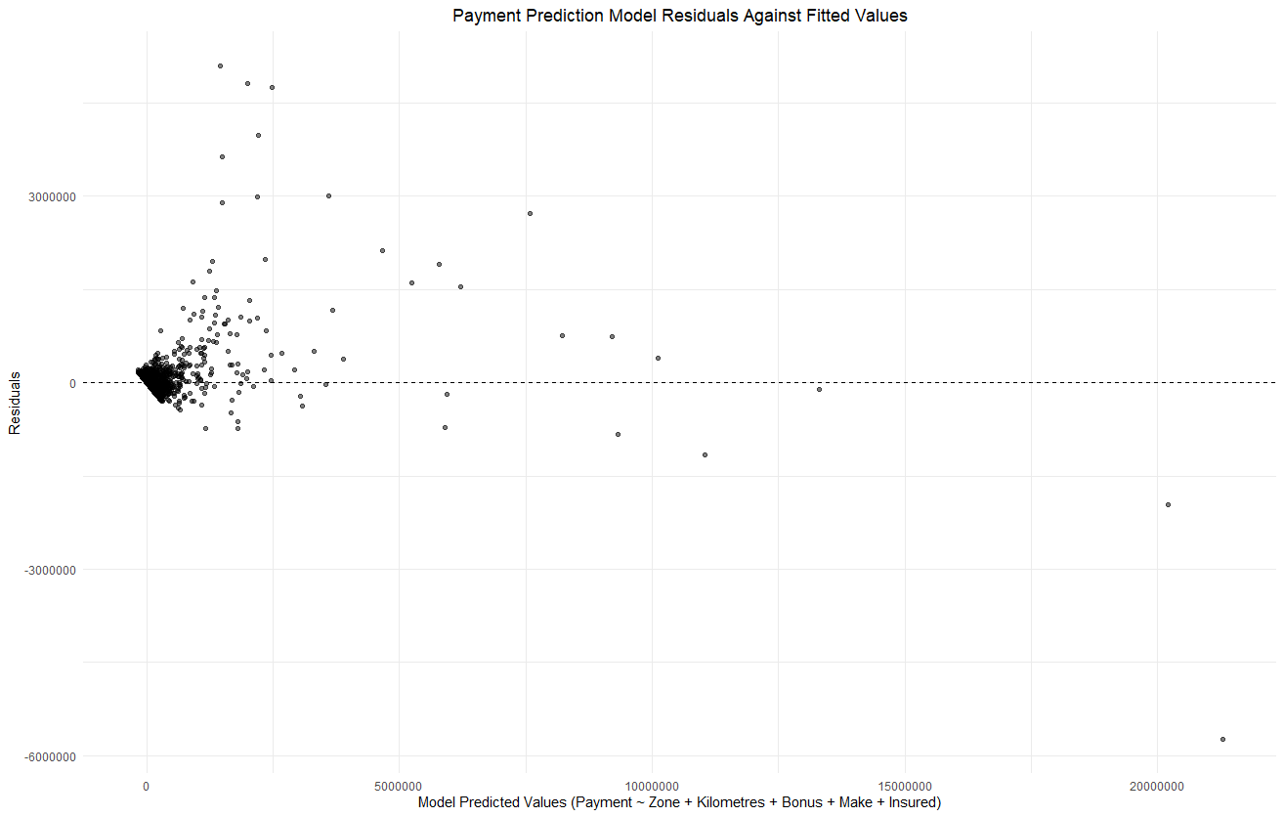
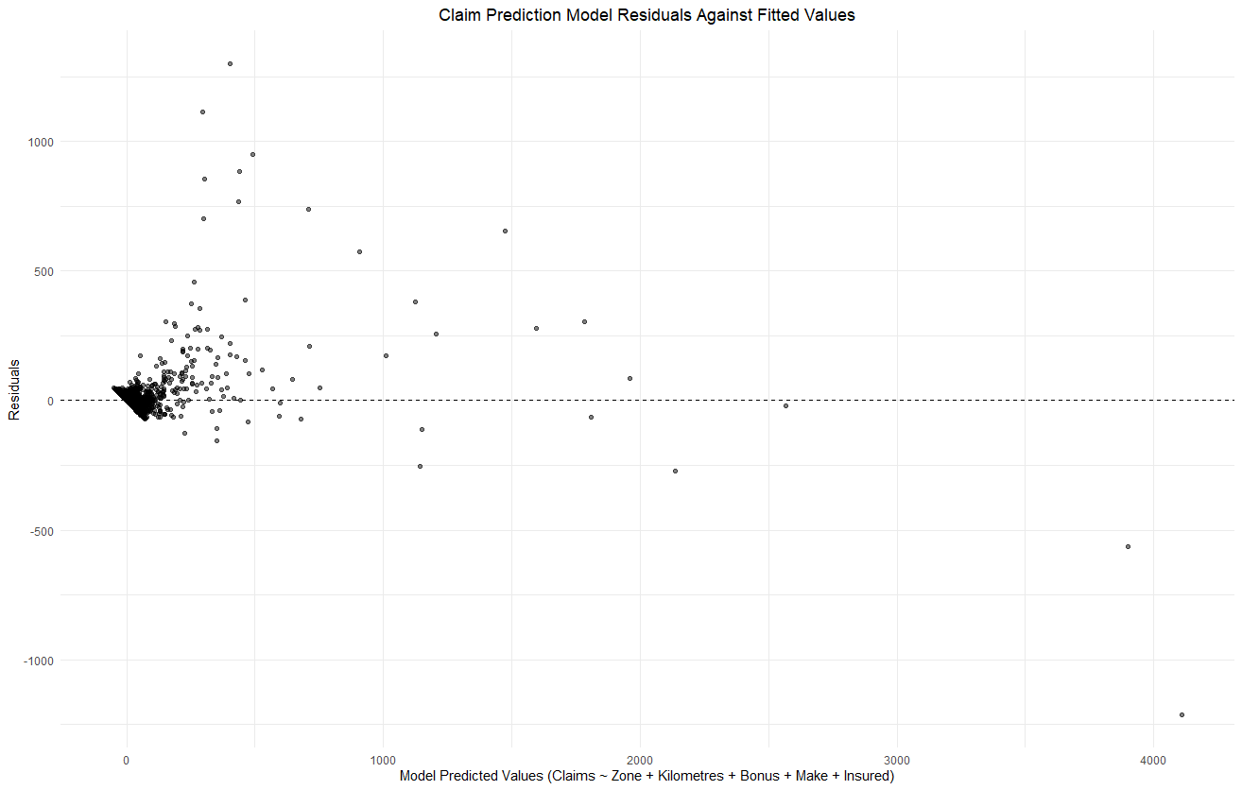
Adapting models for prediction
Payment
Claims
Prediction Model: Zone + Kilometres + Bonus + Make + Insured
R2 = 0.8798, F-Statistic > critical value and p-value below C.I. and VIF 1.034239 .
1.56% of observations had a standardised residual greater than 2.58
Two observations had a cooks distance of greater than 1.
Prediction Model: Zone + Kilometres + Bonus + Make + Insured
R2 = 0.8425, F-Statistic > critical value and p-value below C.I. but VIF 1.034239.
1.8% of observations had a standardised residual greater than 2.58
Two observations had a cooks distance of greater than 1.
Notes:
In order to predict claim numbers and payment values, a new model needed to be created using Zone, Kilometre, Bonus, Make & Insured as independent variables to account for their absence from the models established above. Fit analysis for this model can be seen in Appendix 6 (Payment Model) and Appendix 7 (Claims Model). The same caveats outlined in the previous slides concerning outlier values apply here.

Slide 18
Input variables
Case 1: Vittangi
Case 2: Halmstad
Case 3: Uppsala
Zone 5
8500 km travel per year
Bonus for 2 years
Type 3 cars
4621 policy years
Zone 3
12500 km travel per year
Zero claims bonus (Input of 1)
Type 9 cars
9500 policy years
Zone 2
22300 km travel per year
Bonus for 4 years
Type 3 car
Estimation between 17500 and 25416 policy years
Notes:
As a quick reminder, the query here is by expanding coverage in three cases to a newly defined limits, which is the potential impact on both the number of claims submitted within the regions and their associated payment values, to aid in financial planning.

Slide 19
Predicted Values
Location | Claims | Payment (Skr)
Vittangi | 156.8249 | 805,192.1
Halmstad | 374.0307 | 1,867,116
Uppsala (lower estimate) | 569.7284 | 2,951,236
Uppsala (upper estimate) | 822.0087 | 4,260,746
Location | Current Claim | Predicted New Claims | Claim Increase %age | Current Payment (Skr) | Predicted New Payment (Skr) | Payment Increase %age
Vittangi | 3 | 156.8249 | 5,127.496 | 8,813 | 805,192.1 | 9,036.413
Halmstad | 283 | 374.0307 | 32.16633 | 1,188,075 | 1,867,116 | 57.15473
Uppsala (lower estimate) | 2 | 569.7284 | 28,386.42 | 1,916 | 2,951,236 | 153,931.1
Uppsala (higher estimate) | 2 | 822.0087 | 41,000.44 | 1,916 | 4,260,746 | 222,277.2
Notes:
The values on the previous slide were plugged into the models outlined previously and the predicted impact on both claims and payments in this region can be see in the top table.
To aid in interpretation of this information, the bottom table illustrates the current claim and payment level in the associated zone, distance, make and bonus clusters, in addition to the newly predicted values. in addition to a calculated growth rate for both. Understandably the growth is significant, particularly in case of Uppsala where current coverage of the cluster is limited. Values were established for both the lower and upper bound of the predicted Uppsala Insured variable, and the actual final value will likely reside somewhere within this range.

Slide 20




Thank you
Brian Collins
up2078876@myport.ac.uk
https://github.com/Brian-M-Collins

